Slide 1
Federal Programs
By Jamilah McKenzie and Chadwick Hicks

Slide 2
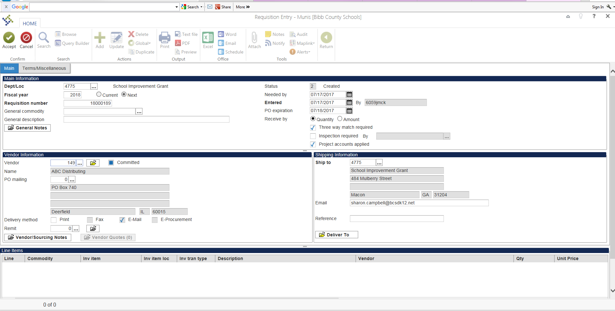
How to enter a requisition with a project String.

Slide 3
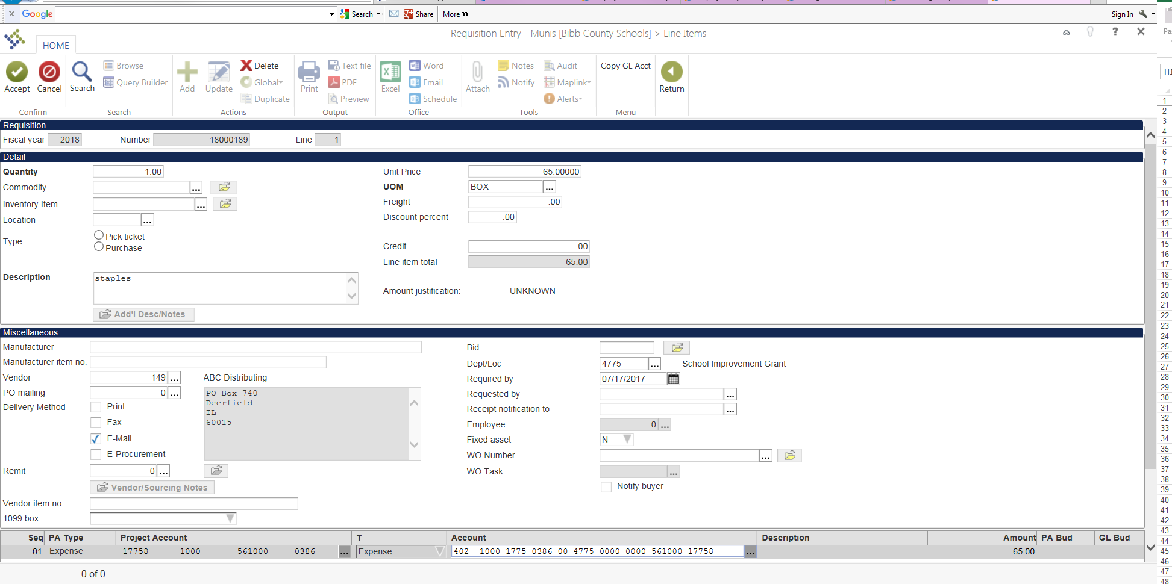
Requisition Lines

Slide 4
Munis>Financials>General Ledger Menu>Inquiries and Reports>YTD Budget Report
Select Segment Find

Slide 5
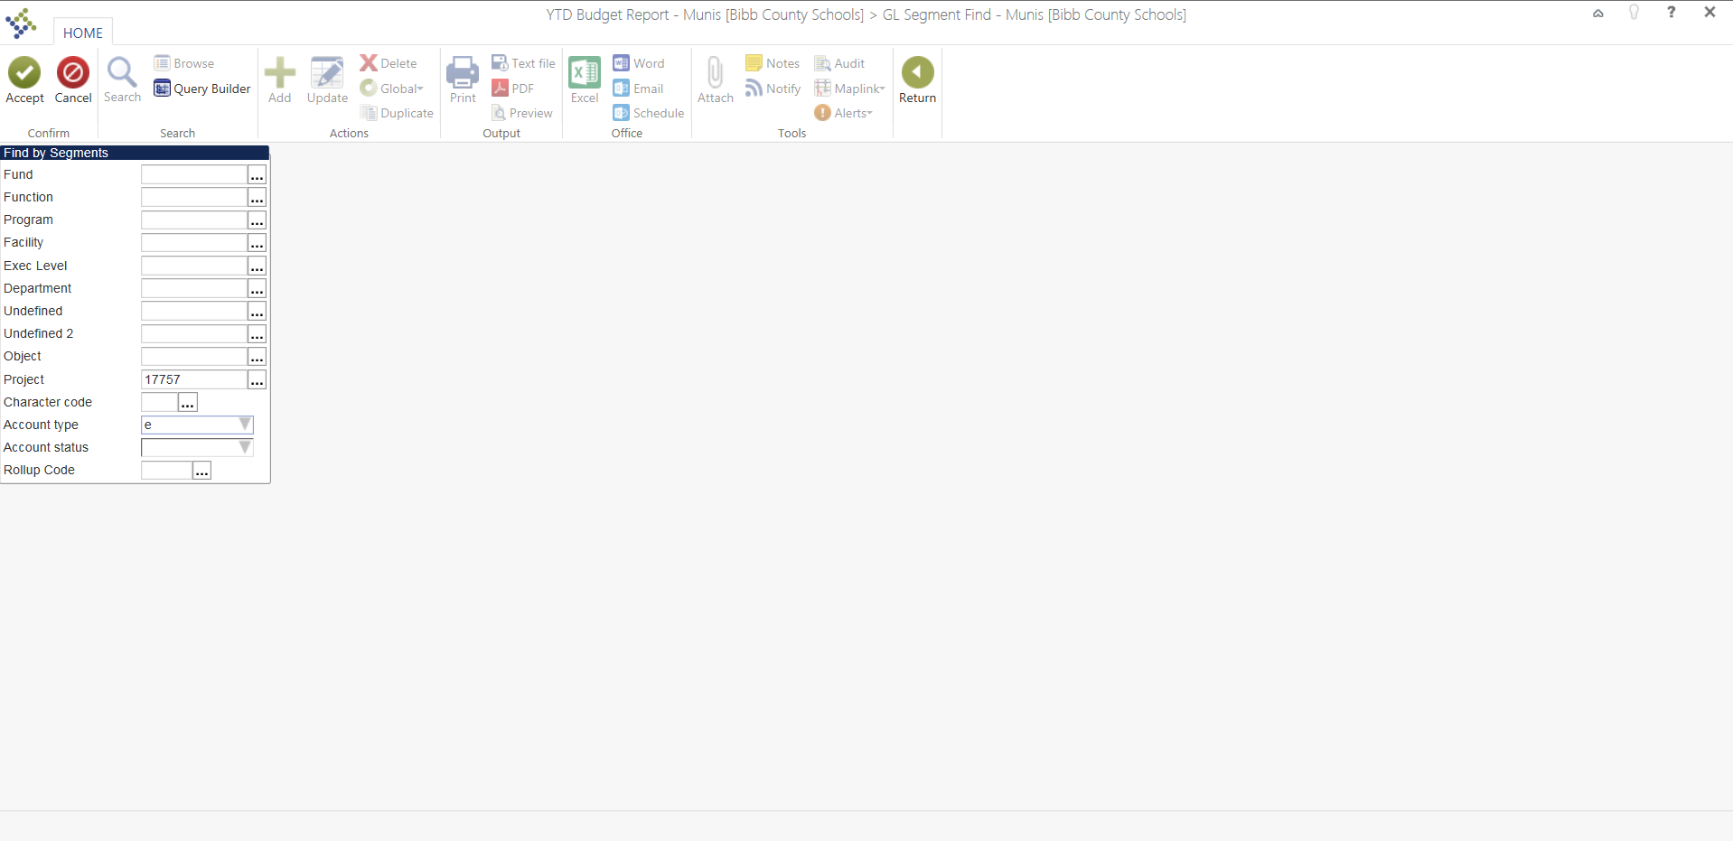
YTD Report Continued
Put project code(ex…17757) in and E for Expense

Slide 6
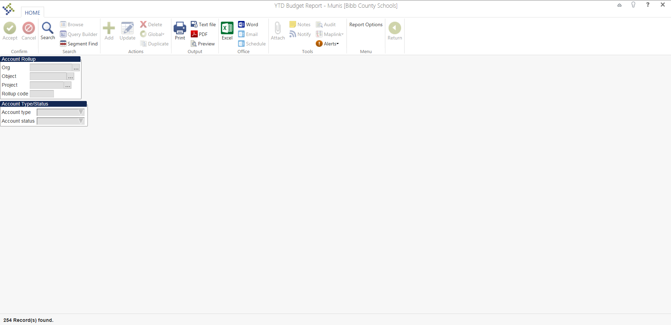
YTD contd…..
This page shows how many records were found and you need to select report options here.

Slide 7
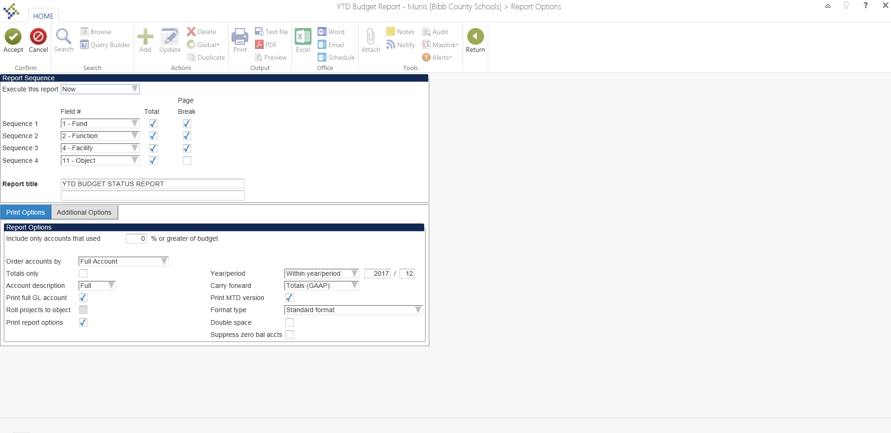
Report Options>Print Options

Slide 8
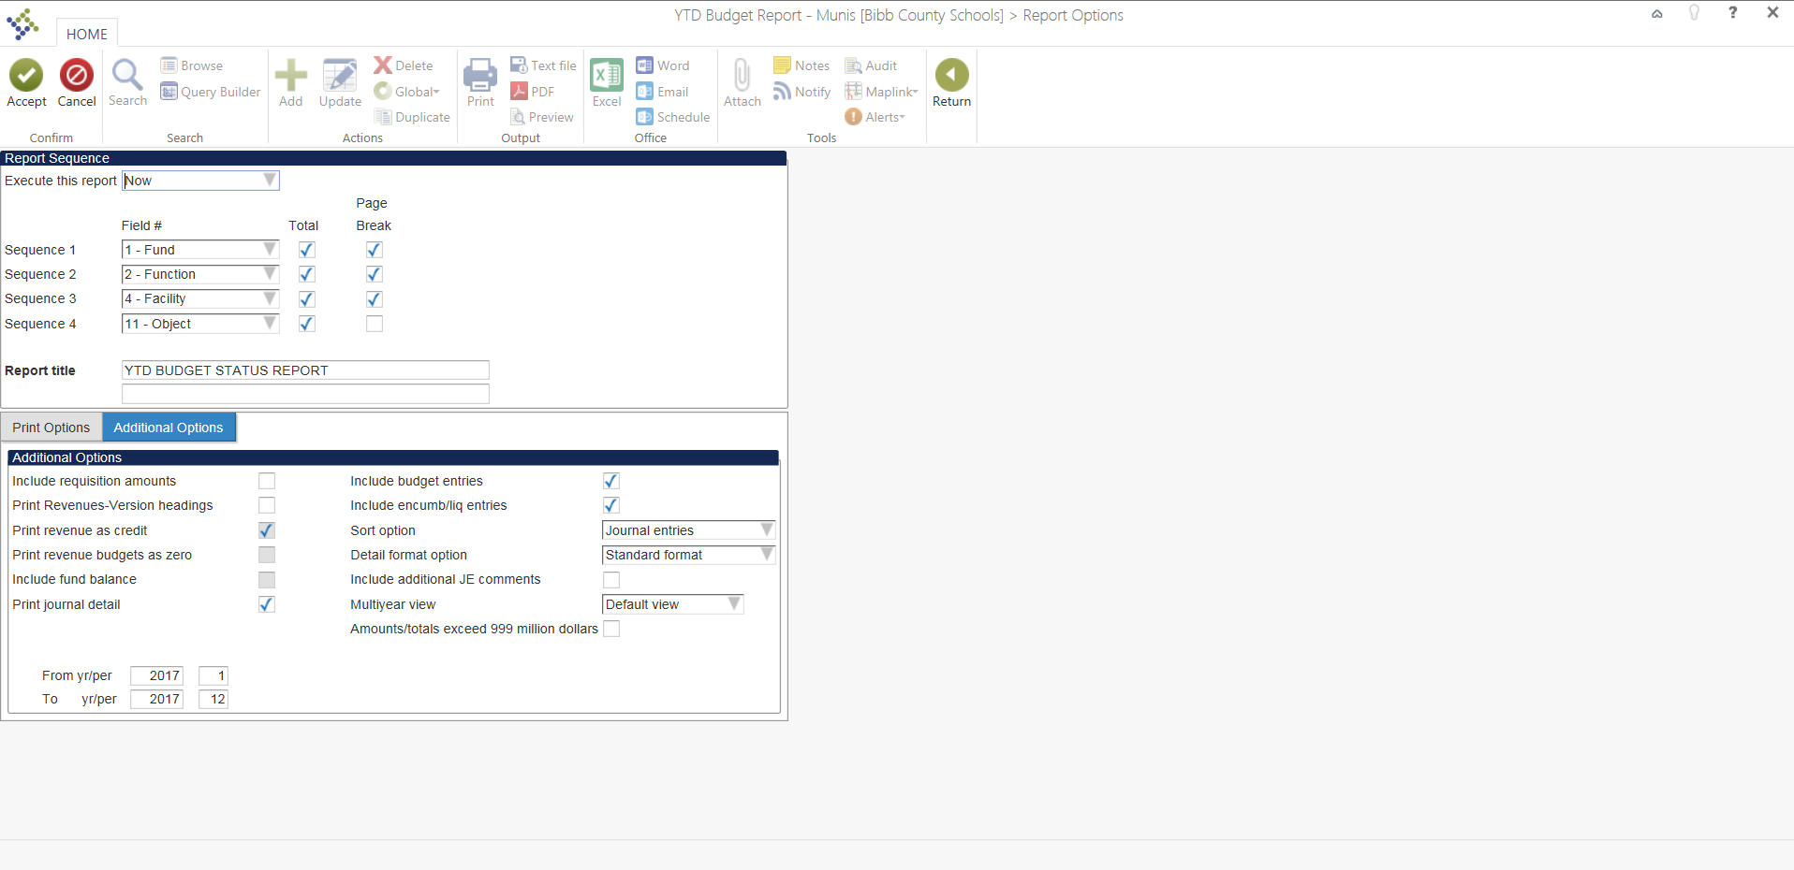
Report Options>Additional Options

Slide 9
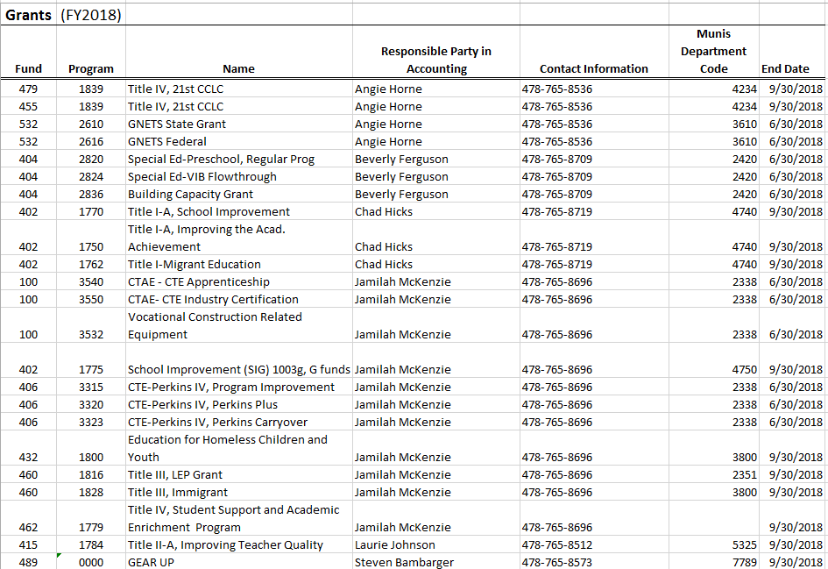
Grant Accounting Contacts

